Slide 1

Volkswagen
Used Car Price Prediction
By Thai Linh Bui

Slide 2
Table of contents
Dataset Description
Data cleaning
Exploratory Data Analysis
Modeling - Car Price Prediction
Difficulties & Improvements

Slide 3
Dataset Description

Slide 4
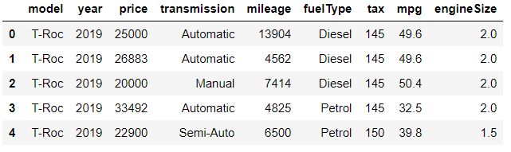
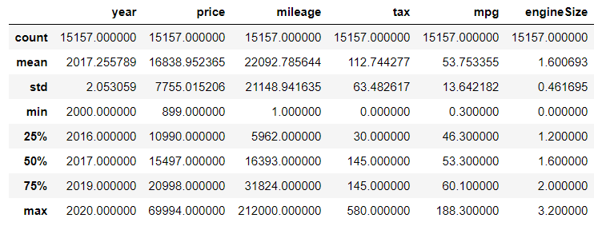
Source: Kaggle
Description:
Used cars in UK (in July 2020)
15 157 rows & 9 columns
No missing values
3 columns out of 9 have the object data type: 'model', 'transmission' and 'fuelType'
The oldest model: 2000
The newest model: 2020.
The price range: 899£ to 69 994£
The mean : 16K£ AND the 75th quantile: 21K£
=> there might be some outliers.
Mileage: there might have outliers
Tax: road tax that owners need to pay every year

Slide 5
Data cleaning

Slide 6
Data cleaning
In the column 'model', there is a white space preceding each value that needsto be removed
There are several columns to rename

Slide 7
Exploratory Data Analysis

Slide 8
Categorical values

Slide 9
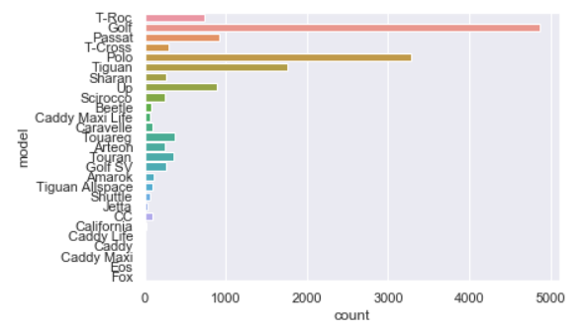
Distribution of categorical values
Distribution of car by model

Slide 10
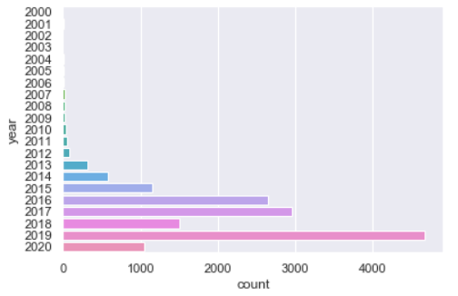
Distribution of categorical values
Distribution of car by year

Slide 11
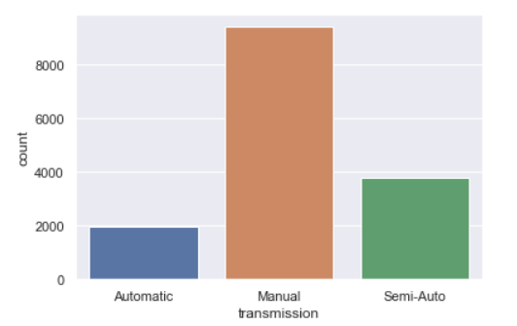
Distribution of categorical values
Distribution of cars by types of transmission

Slide 12
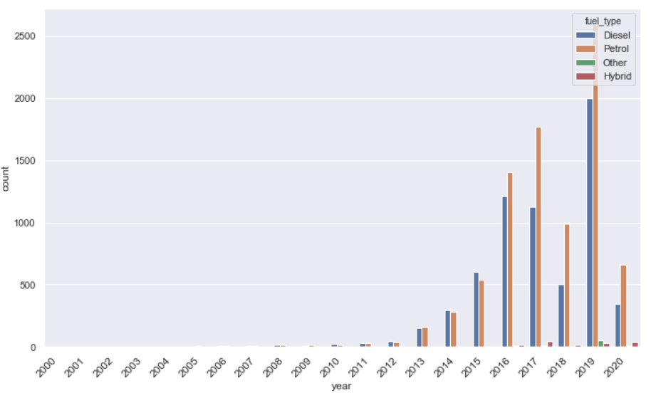
Distribution of categorical values
The petrol is used the most for the commercialized cars since 2016, while diesel was the most common before 2016.
Distribution of cars by types of fuel

Slide 13
Numerical values

Slide 14
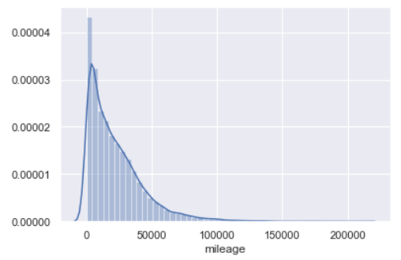
Distribution of numerical values - Mileage
Most of values are less than 50K km
=> might have outliers
=> less accurate while predicting for the cars that have the mileage value > 50K km

Slide 15
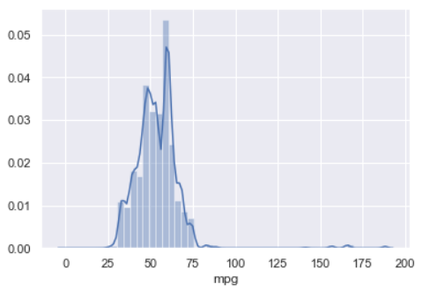
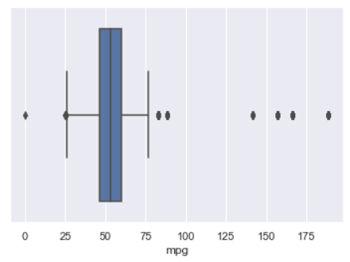
Distribution of numerical values - Mile per gallon
The graph doesn’t really follow the normal distribution.
=> fat tail on the right

Slide 16
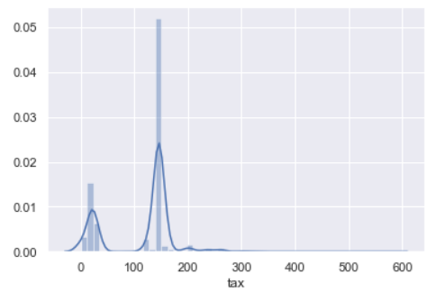
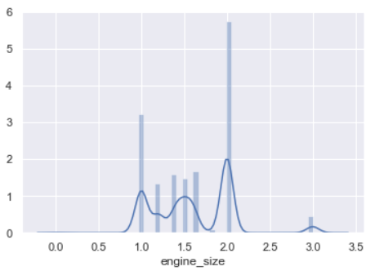
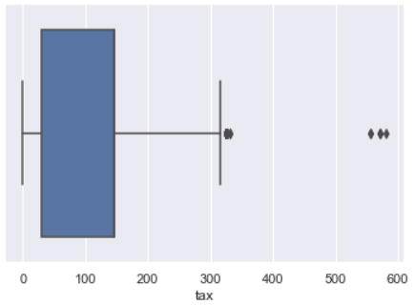
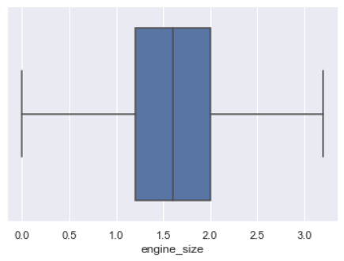
Distribution of numerical values - Tax & Engine size

Slide 17
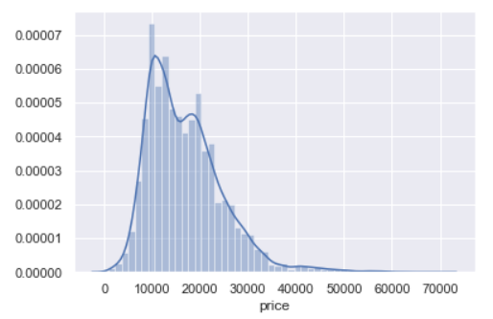
Focus on Price
Distribution
Right skewed distribution

Slide 18
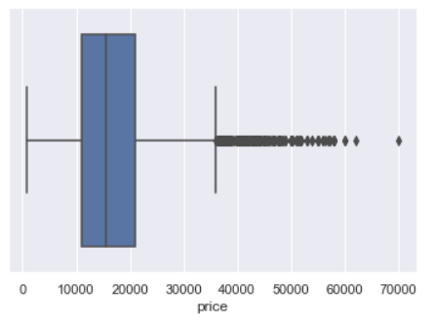
Focus on Price
2. Outliers
Justify the form of the normal distribution
Outliers from the price of 36K£
Question: What models are related the most to the outliers?

Slide 19
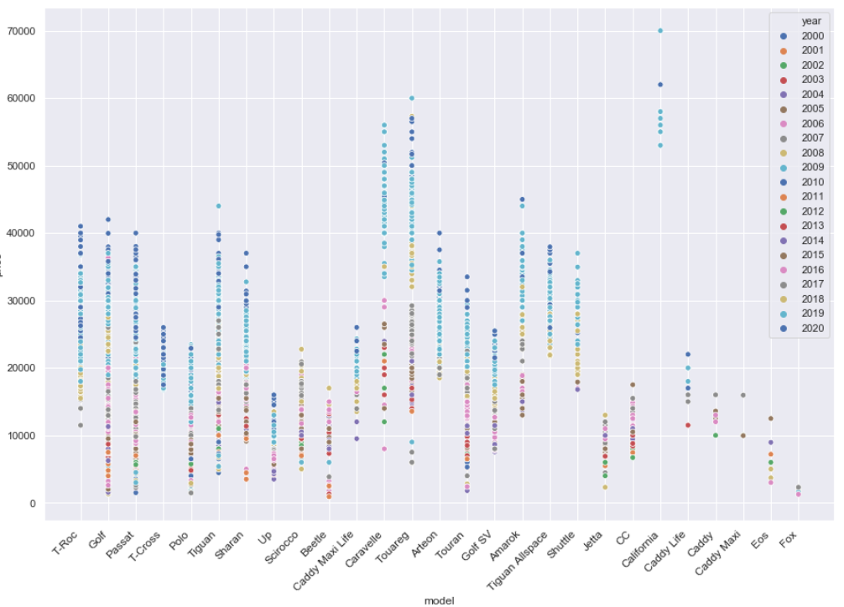

Slide 20
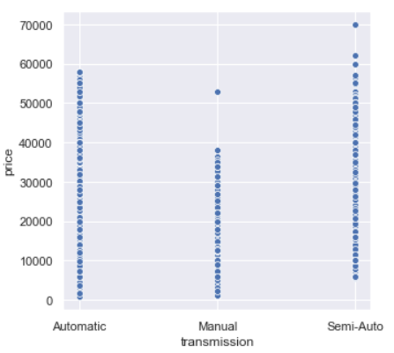
Focus on Price
2. Relationship between Price and Other Variables
Price & Transmission
The semi-auto and automatic cars tend to be more expensive than the manual ones.
Notes:
Improvements: Can use the violin graph

Slide 21
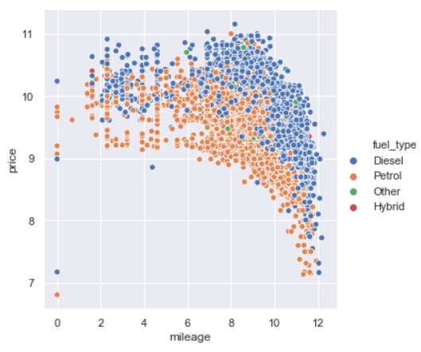
Focus on Price
2. Relationship between Price and other variables
Price & Mileage
The older the car is, the less expensive it is.
Notes:
Improvement: move price to y axe

Slide 22
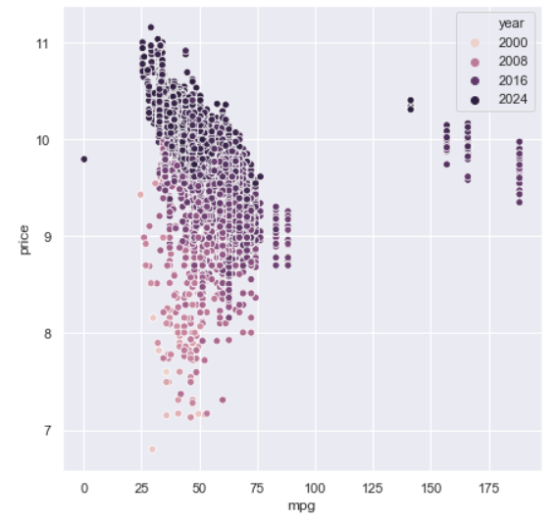
Focus on Price
2. Relationship between Price and other variables
Price & Mile per gallon
The less fuel the car consumes, the more expensive it is.
The older the car is, the less expensive it is even though it consumes not much fuel.

Slide 23
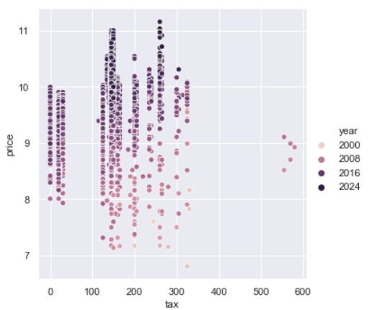
Focus on Price
2. Relationship between Price and other variables
Price & Road tax
There is no evident correlation between the amount of tax road and the car price.
Notes:
Improvements: Can use the violin graph

Slide 24
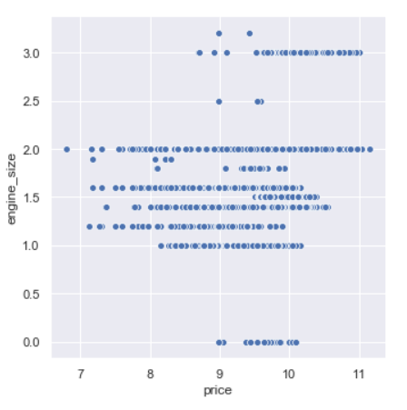
Focus on Price
2. Relationship between Price and other variables
Price & Engine Size
There is seemingly a sign of correlation between the price and the size of the engine.
Notes:
Improvements: Can use the violin graph

Slide 25
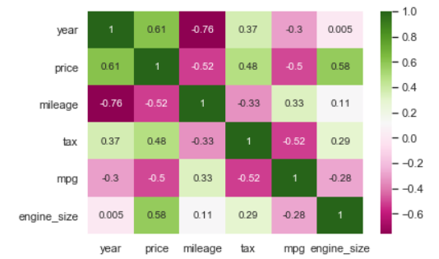
Correlation between all variables
1. Moderate correlation
Price vs Year: 0.61
Price vs Engine_size: 0.58
Price vs Mileage: -0.52
Price vs Mpg: -0.5
Road tax vs Mpg: -0.52
2. High correlation
Mileage vs Year: -0.76

Slide 26
Prediction Modeling

Slide 27
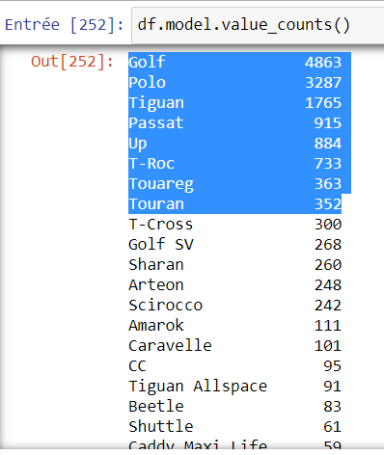
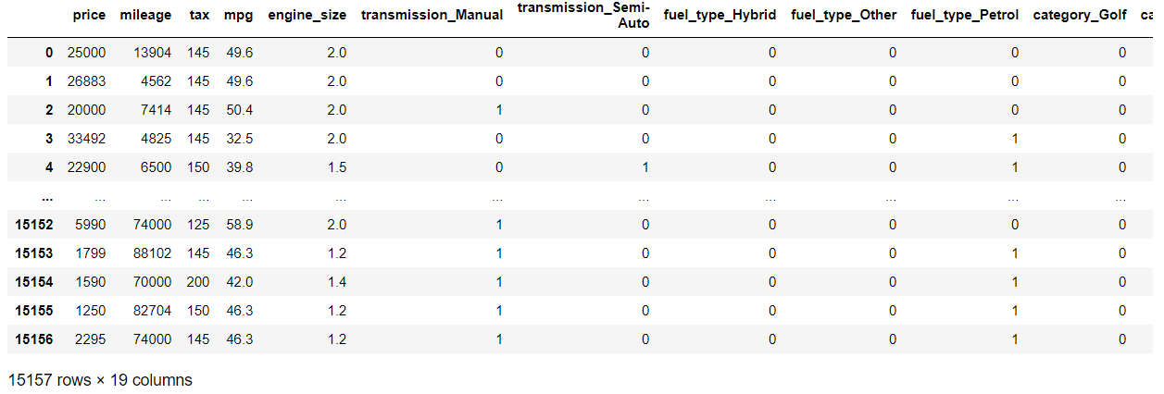
Preparation
Create dummies for categorical columns
Column ‘model’: keep 8 models that contribute the most data to the dataset and group other models in a category “Other”

Slide 28
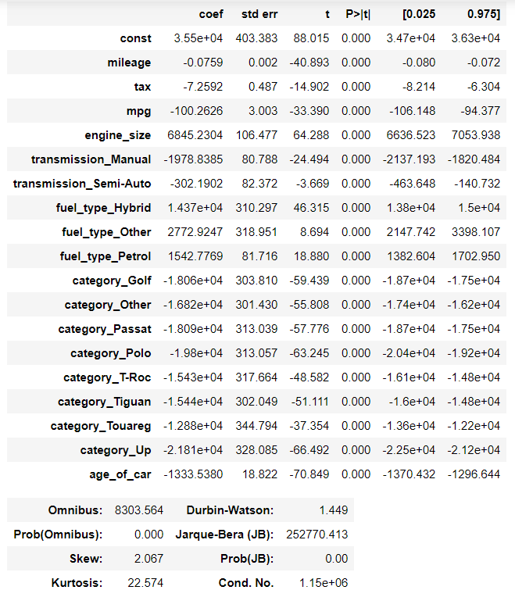
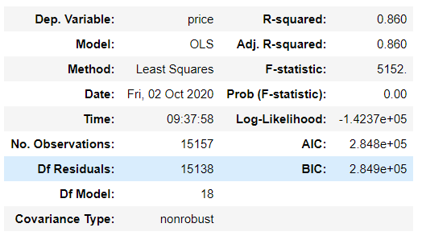
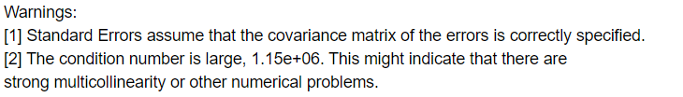
2. Modeling - First Run
Passed indicators:
R^2 & Adj R^2: 86% - Good
Prob (F-statistic): 0 - Good
P>|t| - Pvalue: 0 - Good
Durbin-watson: 1.4 - Good
Failed indicators:
Prob(Omnibus): 0 - Not Good
Warning messages

Slide 29
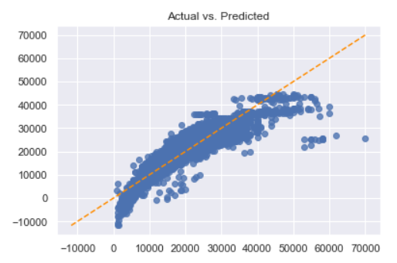
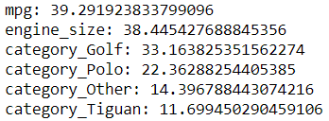
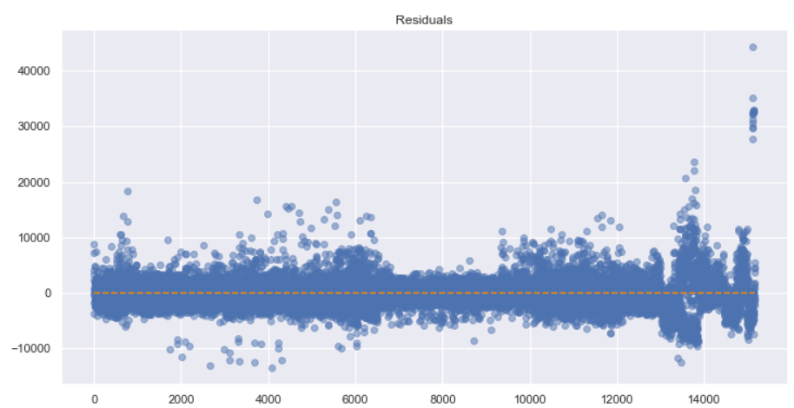
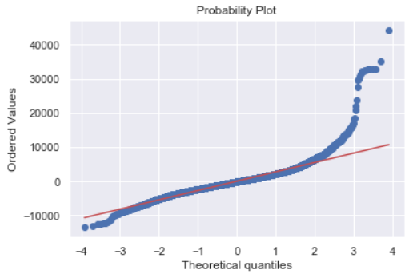
2. Modeling - First Run
Assumption check
Satisfied: Linearity
Potentially violated:
Multicollinearity: 6 variables whose VIF > 10
Heteroskedasticity:
Violated:
Autocorrelation: d = 1.44 < 1.5
Normality: Residuals are not normally distributed

Slide 30
3. Modeling - Second Run
Correction made:
Apply natural logarithm to the values of Price and Mileage -> Assumption - Linearity: line will be more linear
Drop column ‘mpg’ and ‘category_Tiguan’ -> Assumption - Multicollinearity: reduce number of columns whose VIF > 10
Eliminate outliers for all columns except dummies -> Assumption - Homoskedasticity & Normality: less outliers and residual line will have less fat tails.
Normalize the dataset
Shuffle the dataset -> Assumption - Autocorrelation: reduce the risk that there is a specific pattern between values formed by a random order which can impact this assumption
Notes:
Correction made based on the result of the first run

Slide 31
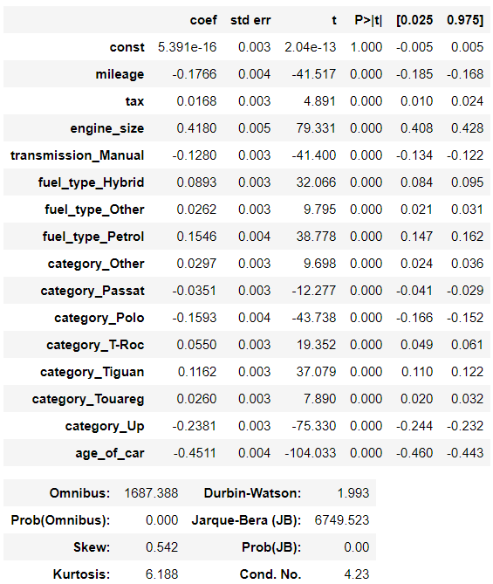
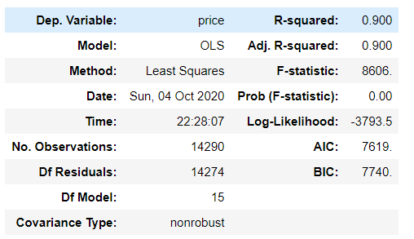
3. Modeling - Second Run
Improved most of the key indicators
Question: why P value of ‘const’ = 1?

Slide 32
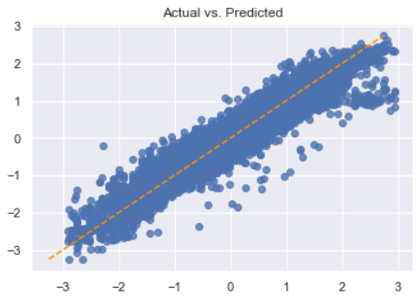
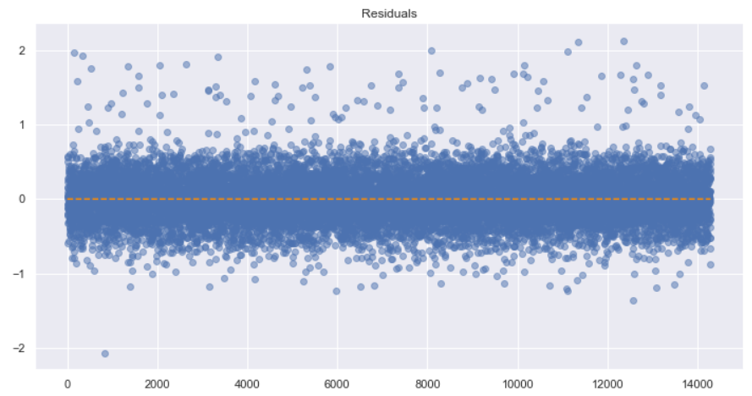
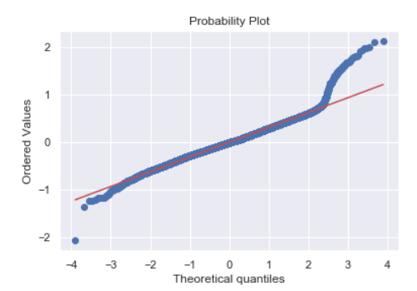
3. Modeling - Second Run
Assumption check
Satisfied:
Linearity
Multicollinearity: no variable having VIF > 10
Autocorrelation: d = 1.99 > 1.5
Potentially violated:
Heteroskedasticity:
Violated:
Normality: Residuals are not normally distributed

Slide 33
Conclusion
Prediction Model:
R-squared: 90%
1 violated assumption need to be remediated

Slide 34
Github
https://github.com/EricBui0201/UK-Car-Price-Prediction

Slide 35
Thank you

